Slide 1
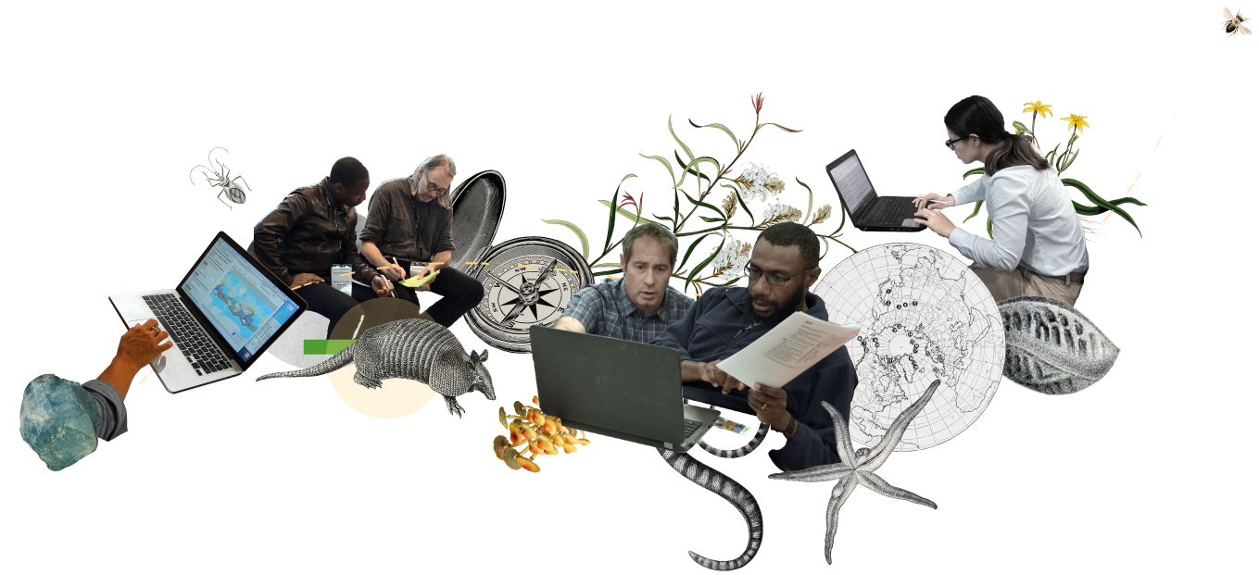
Data Use
Club
gbif.org/data-use-club

Slide 2
What is Data Use Club
The Data Use Club is a space that promotes the interaction between data users and provides them with tools for developing skills in data use, no matter where they are in the world
gbif.org/data-use-club

Slide 3

Training seminars
This quarterly webinar series highlights approaches to global problems using GBIF-mediated data. Each seminar provides opportunities for knowledge exchange and inspiration for GBIF users who wish to develop their own solutions to similar challenges
gbif.org/data-use-club

Slide 4
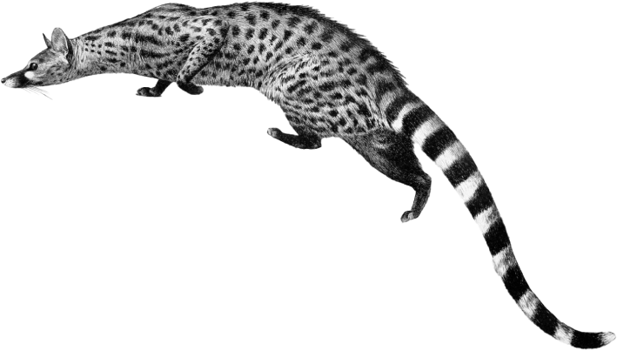
Practical sessions
This quarterly webinar series focuses on developing the informatic and data management skills necessary to fully exploit the potential of GBIF-mediated data. The material for these sessions expands on the biodiversity data use curriculum developed by GBIF
gbif.org/data-use-club

Slide 5

DataCamp online training
GBIF users can receive free access to the full suite of online training offered by DataCamp through DataCamp Donates
gbif.org/data-use-club

Slide 6




Data Use Club resources
Community forum
Get a free DataCamp licence
Guide to cleaning biodiversity data with OpenRefine (available in Spanish only)
Biodiversity data use course
gbif.org/data-use-club

Slide 7
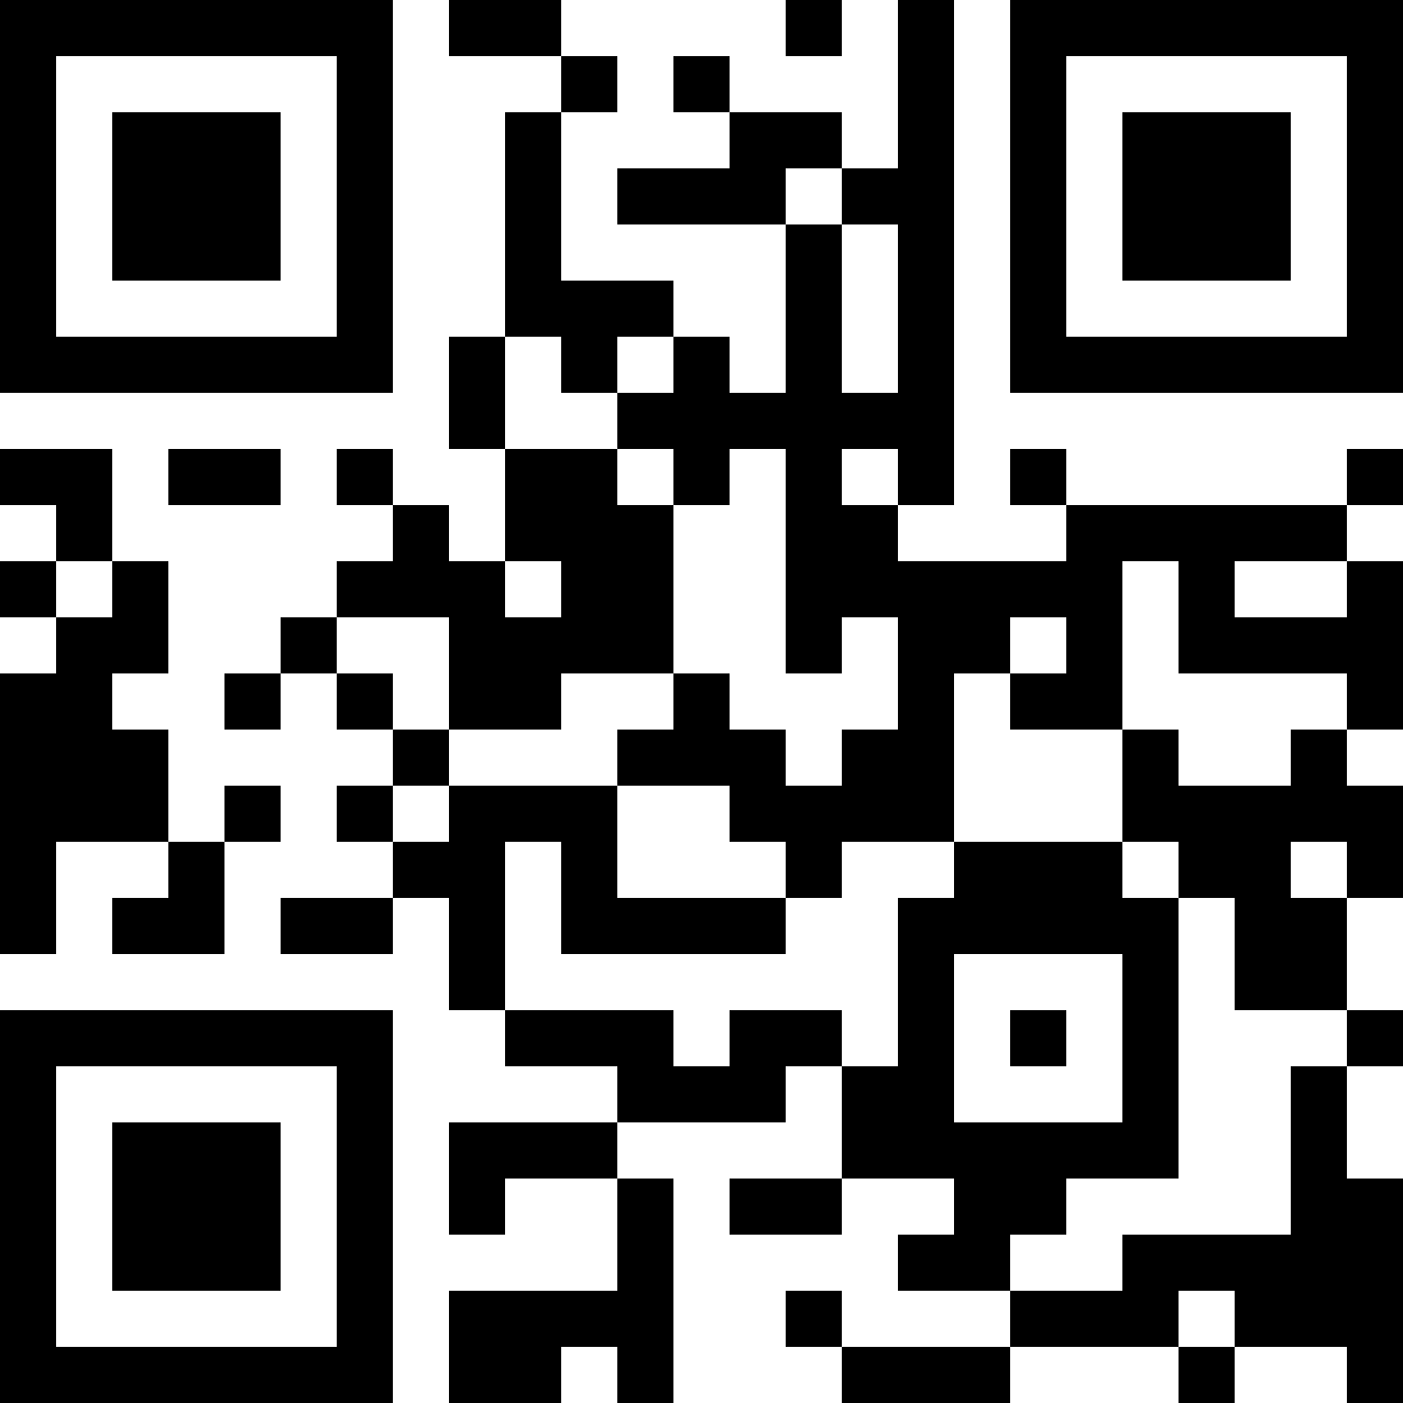
Data Use Club
Learn more!
gbif.org/data-use-club

